Slide 1


Go-Session-9
---------------------
Advanced Concurrency
By Shadab Akhtar

Slide 2
--------------------------------------------------------------------------------------------------
Module Introduction
--------------------------------------------------------------------------------------------------
In this module, we will cover
Understanding Advanced concurrency
Understanding Concurrency Primitives
Understanding Advanced Concurrency Patterns
Understanding Synchronization Techniques
Understanding Advanced Error Handling in Concurrency
Understanding Performance Optimization
Understanding Debugging and Profiling
What is the context ?
Cancelation Options?
Why use context?

Slide 3
------------------------------------------------------------------------------------------------
Understanding Advanced concurrency
------------------------------------------------------------------------------------------------
Advanced concurrency in Go involves mastering techniques for efficiently managing concurrent execution, synchronization, and communication between goroutines.
### 1. Concurrency Primitives:
#### a. Channels:
- Channels are the primary means of communication and synchronization between goroutines in Go.
- They allow goroutines to send and receive values, ensuring safe communication and coordination.
#### b. Mutexes and RWMutexes:
- Mutexes (Mutual Exclusion Locks) and RWMutexes (Reader-Writer Mutual Exclusion Locks) are synchronization primitives used to control access to shared resources.
- Mutexes provide exclusive access, while RWMutexes allow multiple readers or a single writer at a time.
#### c. Wait Groups:
- Wait groups are used to wait for a collection of goroutines to finish execution before proceeding.
- They provide a simple way to coordinate the execution of multiple goroutines.

Slide 4
### 2. Advanced Concurrency Patterns:
#### a. Worker Pools:
- Worker pools are a common pattern for parallelizing tasks across multiple workers (goroutines).
- Tasks are submitted to a pool, and workers concurrently process these tasks.
#### b. Fan-out/Fan-in:
- Fan-out/Fan-in is a pattern where multiple goroutines (fan-out) perform some work in parallel, and their results are aggregated by another goroutine (fan-in).
- It's useful for parallelizing workloads and aggregating results efficiently.
#### c. Contexts for Cancellation and Timeout:
- The `context` package provides a way to propagate cancellation signals and deadlines across a tree of goroutines.
- It's useful for handling timeouts, cancellation, and managing resources in a structured way.
### 3. Synchronization Techniques:
#### a. Atomic Operations:
- The `sync/atomic` package provides atomic operations for basic types like integers and pointers.
- Atomic operations allow for synchronization without mutexes, reducing contention and improving performance in some cases.

Slide 5
#### b. Once:
- The `sync.Once` type provides a mechanism for running initialization code exactly once, regardless of how many times it's called from concurrent goroutines.
### 4. Advanced Error Handling in Concurrency:
#### a. Error Propagation in Goroutines:
- Handling errors in concurrent programs requires careful consideration of error propagation across goroutines.
- Techniques like error channels or synchronization primitives can be used to propagate errors effectively.
#### b. Contextual Errors and Context Package:
- The `context` package can be used to propagate errors along with cancellation signals and deadlines across goroutines.
- Contextual errors provide additional context about the error's origin and help in debugging and tracing.
### 5. Performance Optimization:
#### a. Fine-Grained Locking:
- Avoiding unnecessary locking and using fine-grained locking can help improve parallelism and reduce contention in concurrent programs.

Slide 6
#### b. Goroutine Pools:
- Managing the creation and lifecycle of goroutines can impact performance.
- Goroutine pools can be used to limit the number of concurrently executing goroutines and manage resource usage effectively.
### 6. Debugging and Profiling:
#### a. Race Condition Detection:
- Race conditions can occur in concurrent programs when multiple goroutines access shared data without proper synchronization.
- Go provides tools like the `-race` flag for detecting and debugging race conditions.
#### b. Profiling Tools:
- Go provides built-in profiling tools like `pprof` for profiling CPU, memory, and goroutine usage in concurrent programs.
- Profiling can help identify bottlenecks and optimize the performance of concurrent applications.
By mastering these advanced concurrency concepts and techniques, developers can write efficient, scalable, and reliable concurrent programs in Go. Effective use of concurrency primitives, synchronization techniques, and error handling can lead to high-performance and robust concurrent applications.

Slide 7
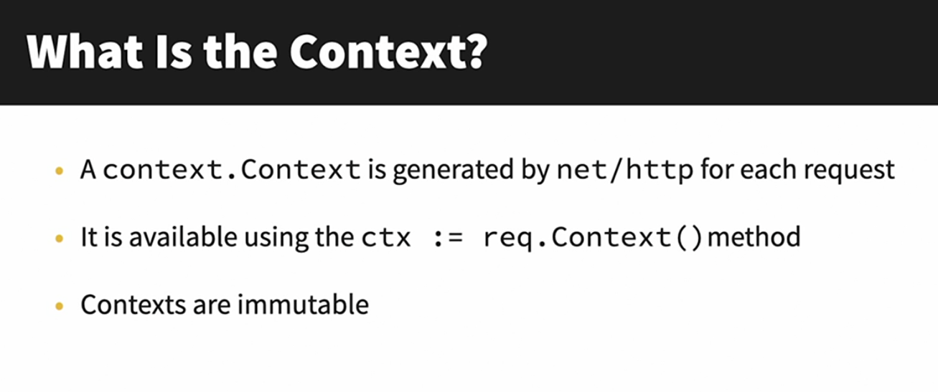

Slide 8
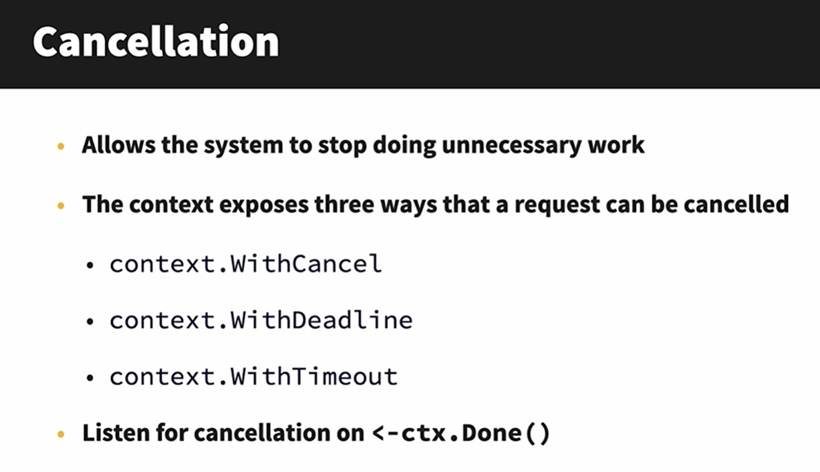

Slide 9
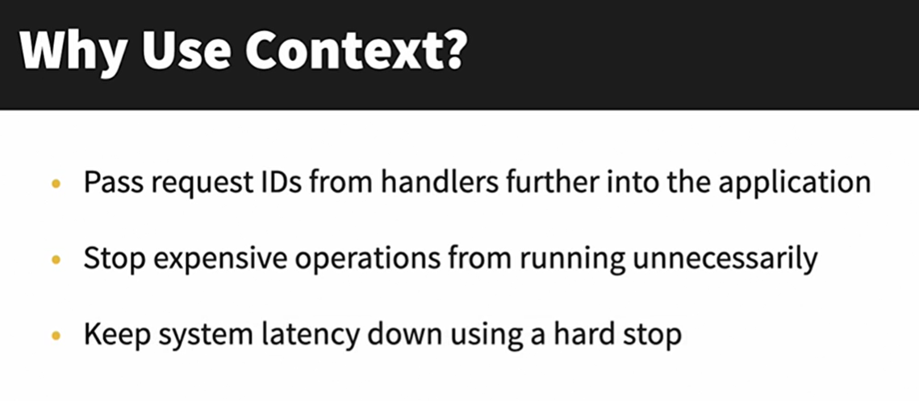

Slide 10
--------------------------------------------------------------------------------------------------
Module Summary
--------------------------------------------------------------------------------------------------
In this module, we have covered
-------------------------------
Understanding Advanced concurrency
Understanding Concurrency Primitives
Understanding Advanced Concurrency Patterns
Understanding Synchronization Techniques
Understanding Advanced Error Handling in Concurrency
Understanding Performance Optimization
Understanding Debugging and Profiling
What is the context ?
Cancelation Options?
Why use context?

Slide 11


Slide 12


